Slide 1


Work-Life Balance
Team Name: Galaxy
Team Members
Aagam Shah (8935540)
Pragnesh Chaudhary (8937680)
Rishi Patel (8940502)
Urvish Sangani (8947081)
Yug Patel (8938573)

Slide 2



Place first and make your life worth, rather than just staying on work

Slide 3



Introduction
Issue: Work-Life Balance,
Definition: “Equally prioritizing, managing, and handling personal life as well as professional roles and responsibilities to have healthy well-being in day-to-day life without stress or struggles.” (Bonifacio, 2024),
Significance: Health, social, mental, bonding with family, friends, and other connections, Satisfaction of working, Productivity, and so on.
Why it is an issue? Because of Heavy workload, working beyond limits, cultural issues, stress, inflation, Tension, etc.

Slide 4


Leadership Analysis:
“ Work-life balance will challenge current Transactional Leadership,
Task Completion,
Rewards Method,
Traditional Thinking
Old defined Rules preferred ”
(Kau, 2024, Module 6, Slide 12)

Slide 5
Leadership Analysis:
“Best style to overcome challenges: Transformational Leadership.
Impact the current culture and changes necessary to adopt are:
Right behavior like Hard work recognition
Prioritize Moral, Ethics, etc.
Dynamic Rules to bring new thinking.
Brings communication, building bonds”
(Kau, 2024, Module 6, Slide 12)

Slide 6


Proposed Route of Action:
The systematic process of handling work-life balance is Transformational Leadership. The advantages are empathy, empowerment, and inclusivity while incorporating practices.
Flexible Work Culture
Define a Vision of work-life balance
Always Celebrate Success
Example: Appreciate Efforts, motivations

Slide 7


Implementation:
How will the organization action the plan?
The plan will be executed at different forums, platforms, and levels such as team meetings, trainings, events, emails, review sessions, etc.
Who will be involved?
CEO, CFO, Executives
Program Managers
HR
Employees
When and how long will it take?
Week 1: Publishing Communication
Week 2: Conduct Surveys, Feedback
Week 3: Organization-wide Rollout
Week 4: Monitoring Culture

Slide 8
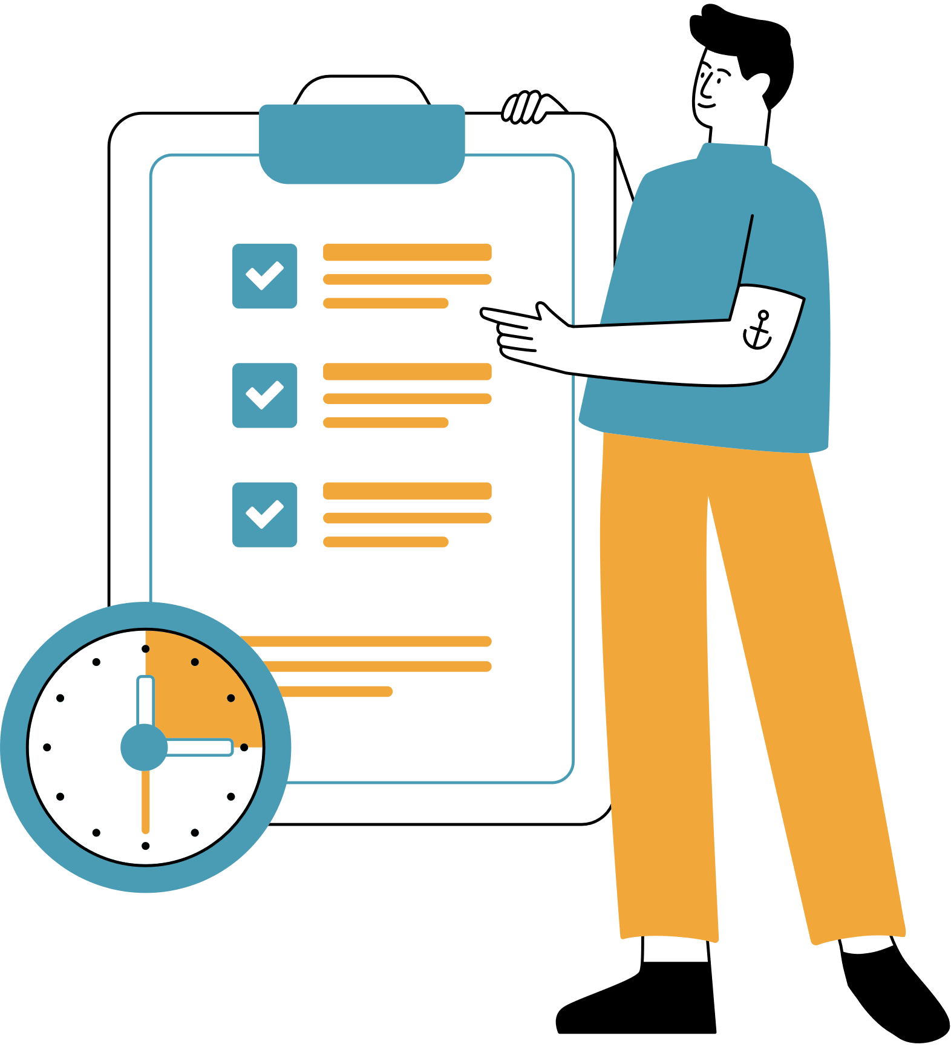

Measuring Return on Investment (ROI):
With Behavioural and Numerical Measures, we can know how the plan can be improved and by observing its acceptance.
Success can be measured by managers, leaders, HR, etc.
Feedback, Surveys
Questionnaire
Appraisals
Performance Metrics KPI’s
When will you measure it?
Monthly
Quarterly
Half Yearly
Yearly

Slide 9


Summary
3 key take away items.
It is important to bring change to increase human well-being, increase productivity, have a stable work culture, and manage a balanced social, physical, and personal life in order to reduce stress and workloads.
The leadership required to do so are Management, Program Managers, Managers, and Leaders; HR is necessary to encourage, motivate, inspire, promote work culture, and create a culture with positive surroundings.
The plan moving forward is to provide flexibility in terms of finance, workability, better vision, and recognition of efforts, skills, and accomplishments.

Slide 10
References:
Bonifacio, R. (2024, November 22). Work-Life Balance Definition: A complete guide- shiftbase. Shiftbase. https://www.shiftbase.com/glossary/work-life-balance
Kau, J., (2024). Module 12: Shaping Culture & Values https://conestoga.desire2learn.com/d2l/le/content/1254016/viewContent/26471323/View

Slide 11
Thank you

